Slide 1
Object-Oriented Programming
(OOP)
Lecture No. 6

Slide 2
Class Compatibility
A class is behaviorally compatible with another if it supports all the operations of the other class
Such a class is called subtype
A class can be replaced by its subtype

Slide 3
…Class Compatibility
Derived class is usually a subtype of the base class
It can handle all the legal messages (operations) of the base class
Therefore, base class can always be replaced by the derived class

Slide 4
Example – Class Compatibility
Shape
color
vertices
move
setColor
draw
Triangle
Circle
Line
angle
radius
length
draw
computeArea
draw
computeArea
draw
getLength

Slide 5
Example – Class Compatibility
File
size
…
open
print
…
PS File
ASCII File
PDF File
…
…
…
print
…
print
…
print
…

Slide 6
Polymorphism
In general, polymorphism refers to existence of different forms of a single entity
For example, both Diamond and Coal are different forms of Carbon

Slide 7
Polymorphism in OO Model
In OO model, polymorphism means that different objects can behave in different ways for the same message (stimulus)
Consequently, sender of a message does not need to know exact class of the receiver

Slide 8
Example – Polymorphism
draw
Shape
View
draw
Line
Circle
Triangle
draw
draw
draw

Slide 9
Example – Polymorphism
print
File
Editor
print
ASCII File
PDF File
PS File
print
print
print

Slide 10
Polymorphism – Advantages
Messages can be interpreted in different ways depending upon the receiver class
draw
Shape
View
draw
Line
Circle
Triangle
draw
draw
draw

Slide 11
Polymorphism – Advantages
New classes can be added without changing the existing model
draw
Shape
View
draw
Square
Line
Circle
Triangle
draw
draw
draw
draw

Slide 12
Polymorphism – Advantages
In general, polymorphism is a powerful tool to develop flexible and reusable systems

Slide 13
Object-Oriented Modeling
An Example

Slide 14
Problem Statement
Develop a graphic editor that can draw different geometric shapes such as line, circle and triangle. User can select, move or rotate a shape. To do so, editor provides user with a menu listing different commands. Individual shapes can be grouped together and can behave as a single shape.

Slide 15
Identify Classes
Extract nouns in the problem statement
Develop a graphic editor that can draw different geometric shapes such as line, circle and triangle. User can select, move or rotate a shape. To do so, editor provides user with a menu listing different commands. Individual shapes can be grouped together and can behave as a single shape.

Slide 16
…Identify Classes
Eliminate irrelevant classes
Editor – Very broad scope
User – Out of system boundary

Slide 17
…Identify Classes
Add classes by analyzing requirements
Group – required to behave as a shape
  “Individual shapes can be grouped together and can behave as a single shape”
View – editor must have a display area

Slide 18
…Identify Classes
Following classes have been identified:
Shape
Line
Circle
Triangle
Menu
Group
View

Slide 19
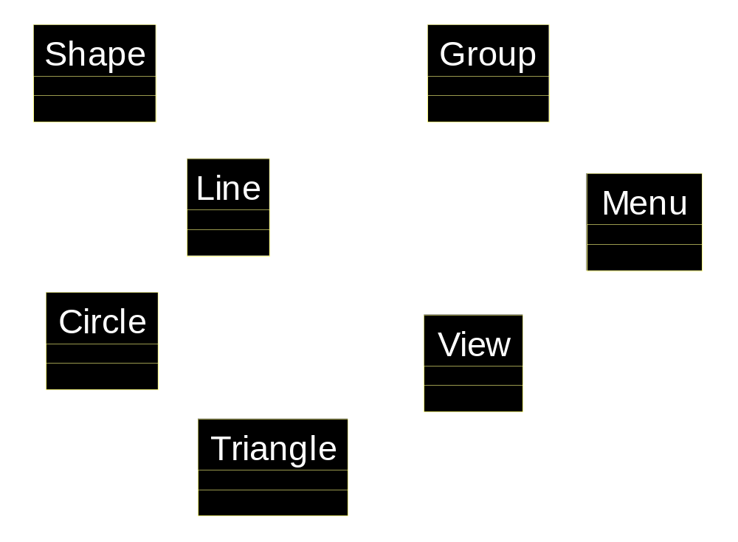
Object Model – Graphic Editor

Slide 20
Identify Associations
Extract verbs connecting objects
“Individual shapes can be grouped together”
  Group consists of lines, circles, triangles
  Group can also consists of other groups
  (Composition)

Slide 21
… Identify Associations
Verify access paths
View contains shapes
  View contains lines
  View contains circles
  View contains triangles
  View contains groups
  (Aggregation)

Slide 22
… Identify Associations
Verify access paths
Menu sends message to View
  (Simple One-Way Association)

Slide 23
Object Model – Graphic Editor
Menu
View
Shape
n
n
n
n
n
n
n
n
n
n
n
Line
n
Circle
Triangle
Group
n
n
n
n
n
n

Slide 24
Identify Attributes
Extract properties of the object
  From the problem statement
Properties are not mentioned

Slide 25
…Identify Attributes
Extract properties of the object
  From the domain knowledge
Line
  Color
  Vertices
  Length
Circle
  Color
  Vertices
  Radius
Triangle
  Color
  Vertices
  Angle
Shape
  Color
  Vertices

Slide 26
…Identify Attributes
Extract properties of the object
  From the domain knowledge
Group
  noOfObjects
View
  noOfObjects
  selected
Menu
  Name
  isOpen

Slide 27




Object Model – Graphic Editor
Menu
View
Shape
name
noOfObjects
color
isOpen
selected
n
n
vertices
n
n
n
n
n
n
n
n
Circle
Line
n
Triangle
Group
length
radius
angle
noOfObjects
n
n
n
n
n
n

Slide 28
Identify Operations
Extract verbs connected with an object
Develop a graphic editor that can draw different geometric shapes such as line, circle and triangle. User can select, move or rotate a shape. To do so, editor provides user with a menu listing different commands. Individual shapes can be grouped together and can behave as a single shape.

Slide 29
… Identify Operations
Eliminate irrelevant operations
Develop – out of system boundary
Behave – have broad semantics

Slide 30
…Identify Operations
Following are selected operations:
Line
  Draw
  Select
  Move
  Rotate
Circle
  Draw
  Select
  Move
  Rotate

Slide 31
…Identify Operations
Following are selected operations:
Triangle
  Draw
  Select
  Move
  Rotate
Shape
  Draw
  Select
  Move
  Rotate

Slide 32
…Identify Operations
Following are selected operations:
Group
  Draw
  Select
  Move
  Rotate
Menu
  Open
  Select
  Move
  Rotate

Slide 33
…Identify Operations
Extract operations using domain knowledge
View
  Add
  Remove
  Group
  Show
  Select
  Move
  Rotate

Slide 34




View
Menu
noOfObjects
Shape
name
selected
color
isOpen
add()
vertices
open()
remove()
draw()
n
group()
n
select()
show()
select()
move()
select()
move()
rotate()
move()
rotate()
n
rotate()
n
n
n
n
n
Line
n
Triangle
Group
n
n
length
angle
noOfObjects
Circle
n
n
draw()
radius
draw()
draw()
n
n
n
draw()
n

Slide 35
Identify Inheritance
Search “is a kind of” by looking at keywords like “such as”, “for example”, etc
“…shapes such as line, circle and triangle…”
  Line, Circle and Triangle inherits from Shape

Slide 36
…Identify Inheritance
By analyzing requirements
“Individual shapes can be grouped together and can behave as a single shape”
  Group inherits from Shape

Slide 37
Refining the Object Model
Application of inheritance demands an iteration over the whole object model
In the inheritance hierarchy,
  All attributes are shared
  All associations are shared
  Some operations are shared
  Others are overridden

Slide 38
…Refining the Object Model
Share associations
View contains all kind of shapes
Group consists of all kind of shapes

Slide 39
…Refining the Object Model
Share attributes
Shape – Line, Circle, Triangle and Group
  Color, vertices

Slide 40
…Refining the Object Model
Share operations
Shape – Line, Circle, Triangle and Group
  Select
  Move
  Rotate

Slide 41
…Refining the Object Model
Share the interface and override implementation
Shape – Line, Circle, Triangle and Group
  Draw

Slide 42
View
Menu
noOfObjects
Shape
name
selected
color
isOpen
vertices
add()
open()
remove()
draw()
n
n
n
group()
n
select()
show()
select()
move()
select()
move()
rotate()
move()
rotate()
rotate()
Line
Circle
Triangle
Group
length
radius
angle
noOfObjects
draw()
draw()
draw()
draw()

Slide 43
View
Menu
noOfObjects
Shape
name
selected
color
isOpen
add()
vertices
open()
remove()
draw()
n
group()
n
select()
show()
select()
move()
select()
move()
rotate()
move()
rotate()
n
rotate()
n
n
n
n
n
Line
n
Triangle
Group
n
n
length
angle
noOfObjects
Circle
n
n
draw()
radius
draw()
draw()
n
n
n
draw()
n

